Slide 1

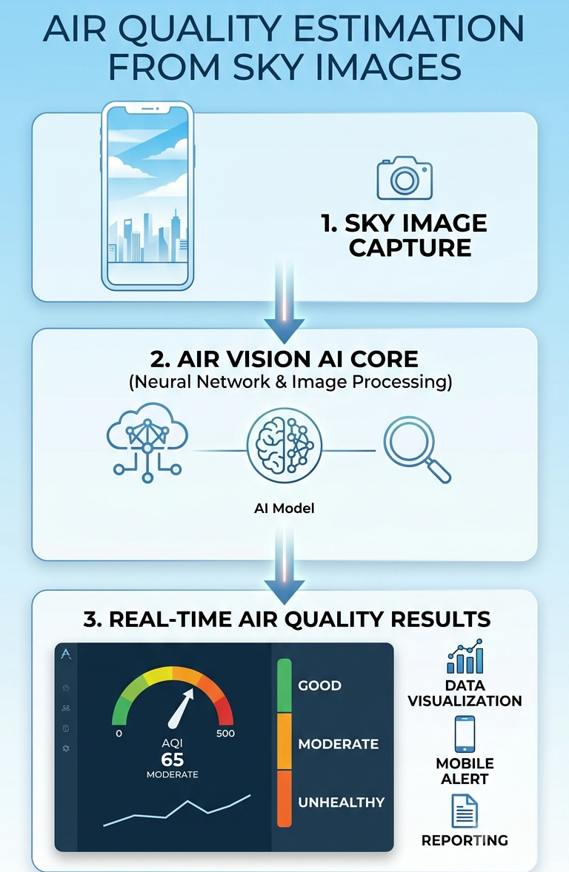
ML PROJECT PRESENTATION
AIRVISION-AI
AIR QUALITY ESTIMATION
FROM SKY IMAGES
Predicting Air Quality Index using Machine Learning, CNNs, and Power BI — for smarter, healthier environments.
Developed by: AASHI DIXIT, GAYATRI, SONAM

Slide 2
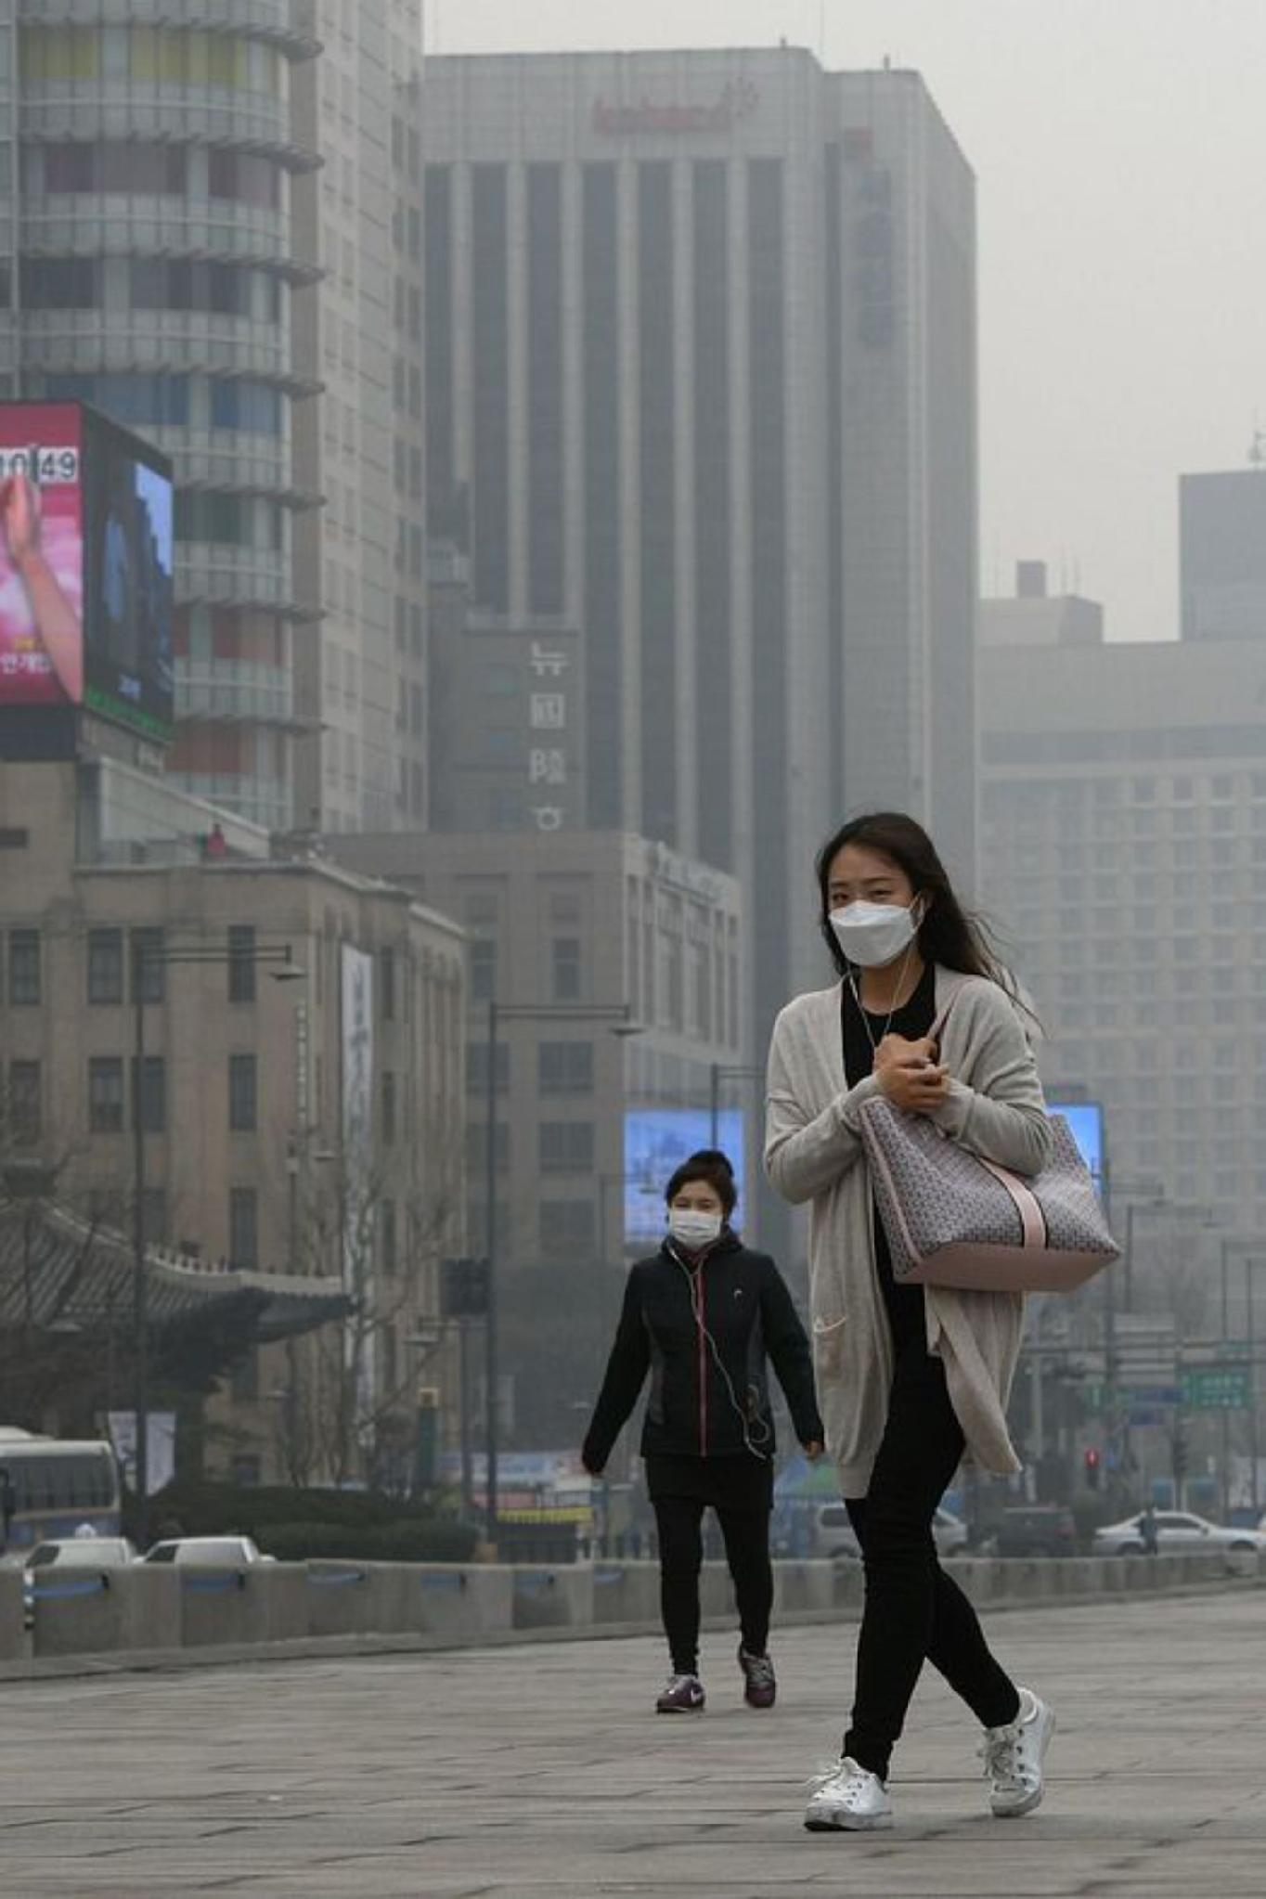
PROJECT OBJECTIVES
Why Air Quality Matters
🌍 Intelligent Monitoring
🏥 Health Assistant
Pollution detection and outdoor health guidance tailored to individual risk profiles.
Real-time AQI prediction using ML to enable proactive environmental decision-making.
📷 Image-Based AQI
CNN-powered AQI detection from images, making air quality assessment visual and accessible.

Slide 3
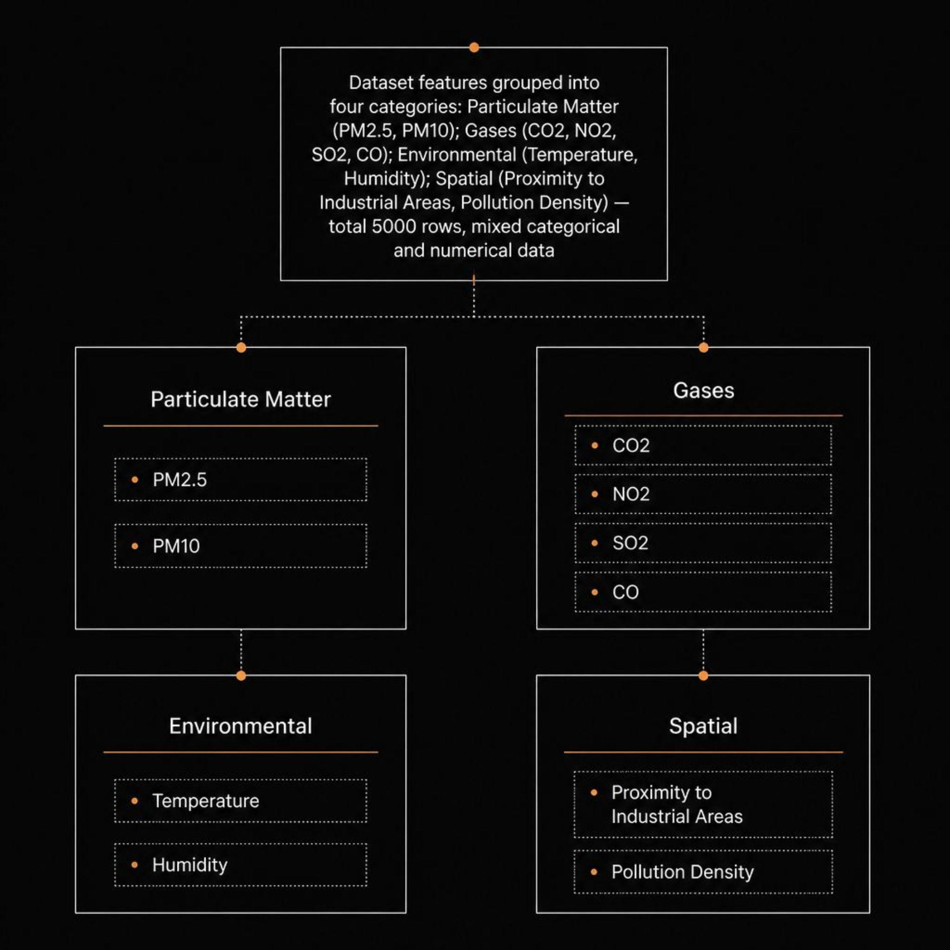
Our Data: Understanding the Air We Breathe
10 Features
Mixed Data Types
PM2.5, PM10, CO2, NO2, SO2, CO, Temp, Humidity, Industrial Proximity, Pollution Density
Categorical + Numerical features requiring preprocessing and encoding

Slide 4

METHODOLOGY
From Raw Data to Insights
Evaluate & Deploy
Data Prep
EDA
Feature Eng
Model Train
Our pipeline combines rigorous preprocessing with multiple ML algorithms, ultimately selecting the best-performing model for production deployment via Power BI.

Slide 5
ALGORITHMS USED:
Linear Regression
Logistic Regression
Decision Tree Regressor
Decision Tree Classifier
Random Forest Regressor
Random Forest Classifier
KNN Regressor
KNN Classifier
K-Means

Slide 6

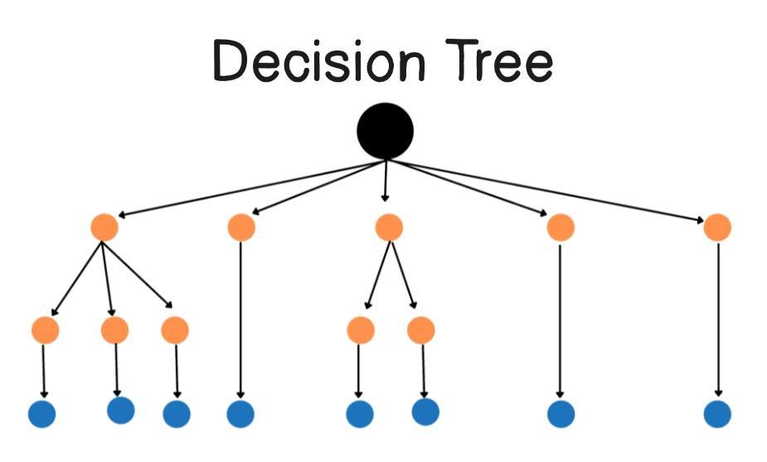
MODEL SELECTION
The Power of Decision Trees
Why Decision Tree Classifier?
After benchmarking Random Forest, KNN, Logistic Regression, and K-Means, the Decision Tree emerged as the optimal choice — balancing accuracy, interpretability, and speed.
Handles Mixed Data
Interpretable
Python Stack
Naturally processes both categorical and numerical features
Transparent decision paths for stakeholder trust
Pandas, Seaborn, Matplotlib, TensorFlow, Scikit-learn

Slide 7
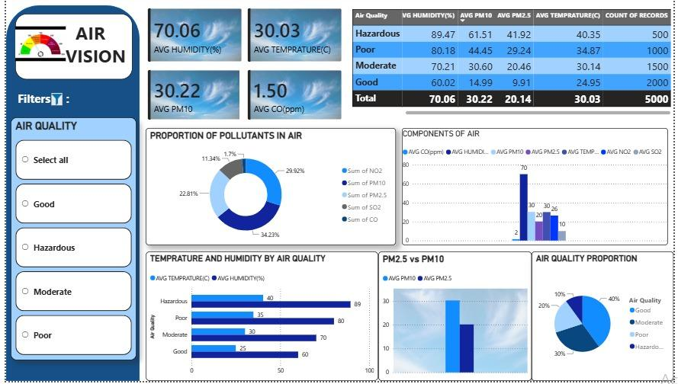
VISUALIZATION
Power BI Dashboard: Air Quality in Action
Interactive AQI Charts
Dynamic visualizations of pollutant levels across regions and time periods.
Geospatial Mapping
Pollution density heatmaps correlated with industrial proximity data.
Real-Time Alerts
Automated thresholds trigger health advisories when AQI exceeds safe limits.

Slide 8
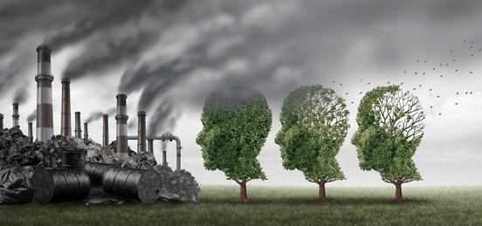
CORE OBJECTIVES
Pollution Detection & Health Assistant
Two Pillars of Our Solution
1
2
Pollution Detection Engine
Outdoor Health Assistant
Classifies pollution sources and severity using PM2.5, PM10, NO2, SO2, and CO signatures to identify industrial vs. vehicular contributors.
Translates AQI predictions into actionable health guidance — recommending safe outdoor activity windows for sensitive groups.

Slide 9
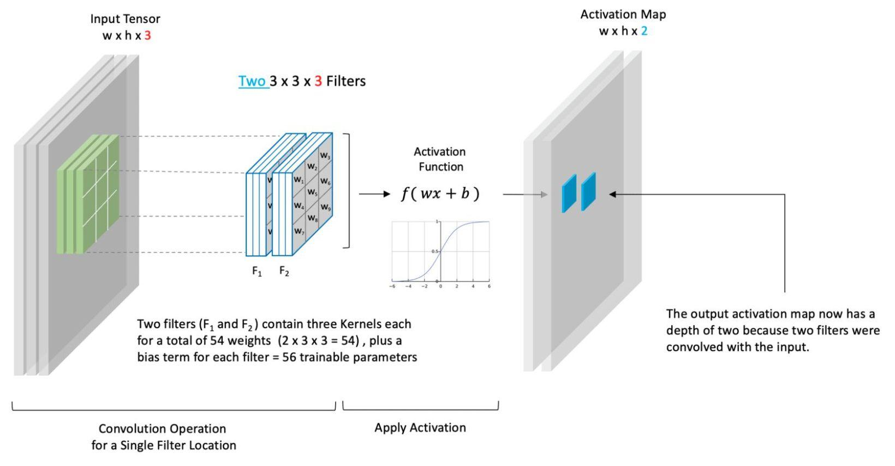
DEEP LEARNING
AQI Detection from Images Using CNNs
Visual Intelligence for Air Quality
Beyond sensor data, our CNN model analyzes sky and landscape images to estimate AQI — enabling air quality assessment in areas without physical monitoring stations.
TensorFlow / Keras
Image → AQI Class
Convolutional layers extract visual pollution features
Good / Moderate / Unhealthy / Hazardous

Slide 10
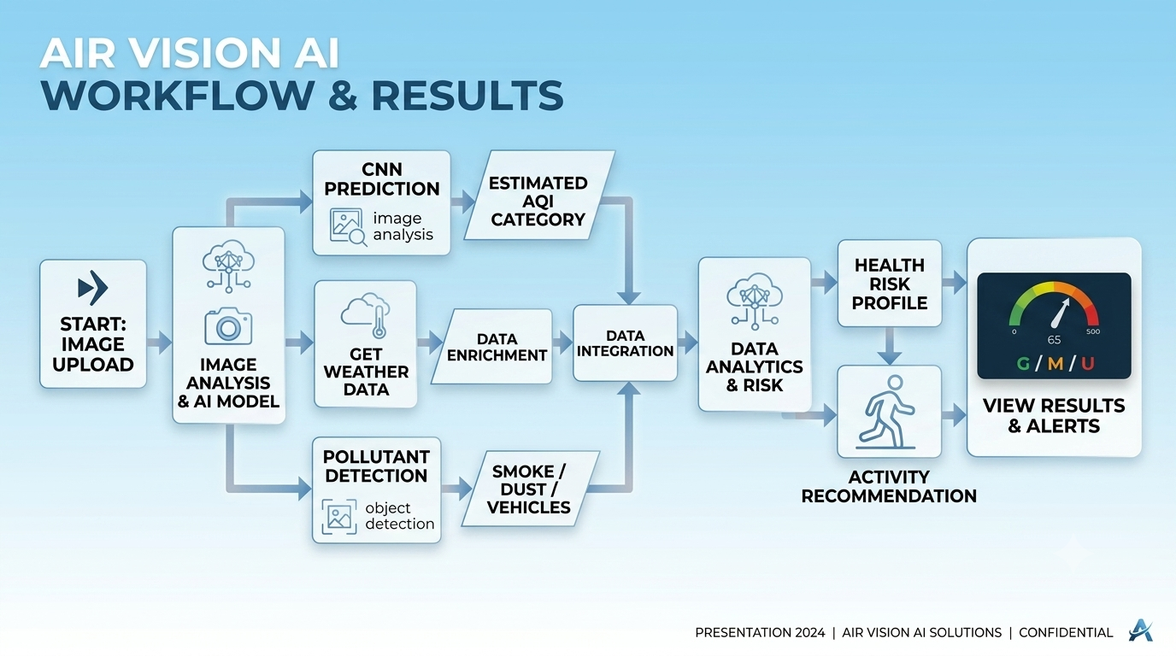

Slide 11
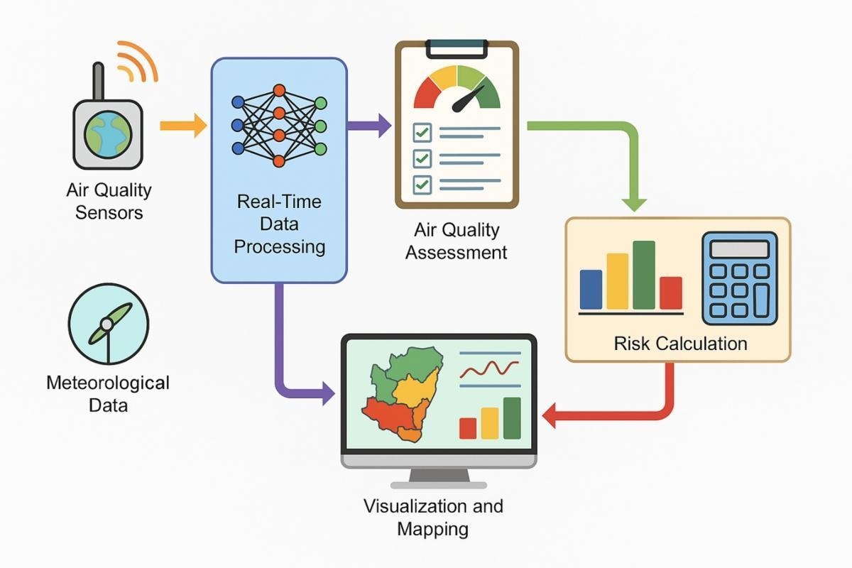
FUTURE SCOPE
Expanding Our Reach & Refinements
1
Phase 1 — IoT Integration
Connect real-time sensor networks for live AQI streaming and automated alerts.
2
Phase 2 — Mobile App
Deploy a citizen-facing app with personalized health recommendations and image-based AQI scanning.
3
Phase 3 — Ensemble Models
Upgrade to Random Forest / XGBoost ensembles for improved accuracy on larger datasets.
4
Phase 4 — City-Wide Deployment
Partner with municipal bodies for smart city integration and policy-level impact.

Slide 12


THANK YOU
Q&A & Concluding Thoughts
5K
Data Rows
Rich, multi-feature dataset
10
Features
Comprehensive pollution indicators
5+
ML Algorithms
Benchmarked & compared
3
Core Objectives
Monitoring, Health, Vision AI
This project demonstrates how Machine Learning, Deep Learning, and Business Intelligence can converge to tackle one of the most pressing environmental challenges of our time — air pollution.

